Slide 1
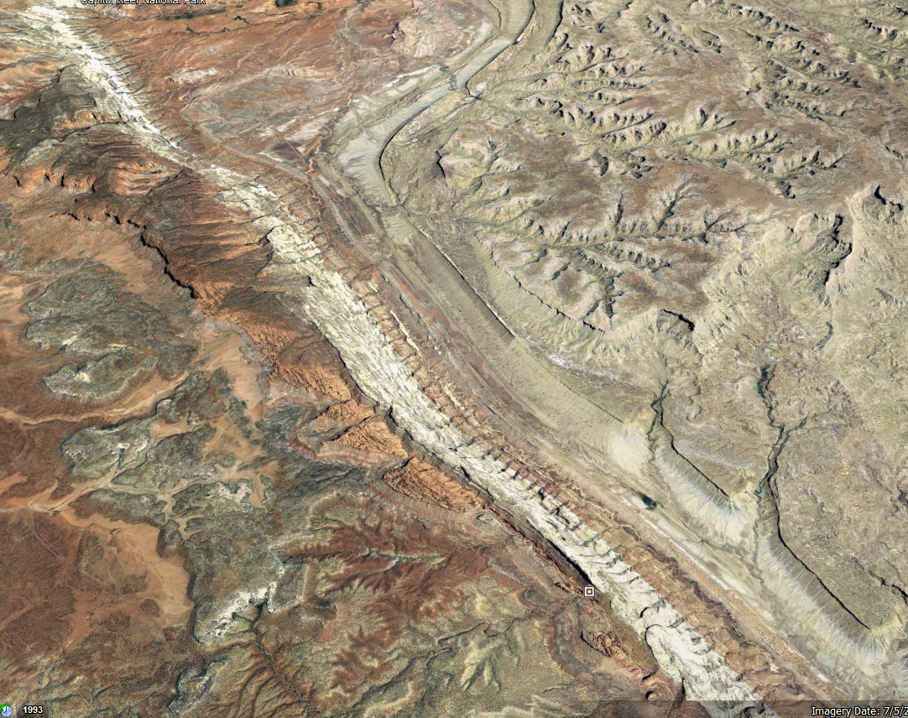
Statistical Models of Water Balance & Modis Derived EVI
Sandy 3 Allotment

Slide 2
Data Sources
CARE HQ daily station data
MODIS Terra 16-Day
Daymet daily 1km at Sandy 3
Used to fill blank missing data in CARE HQ daily station data
Vp, SWE, and sRad (incorporated through 2020)

Slide 3
Analyses
All period Linear Relationships (single and multivariate)
Train Data = 0.75, Test Data =0.25, Randomly sorted
K-fold (5) Cross Validation, Recursive feature selection
Metrics of Comparison: r² / adj. r² & Root Mean Squared Error
Growing Season Period Linear Relationships (single and multivariate)
Train Data = 0.75, Test Data =0.25, Randomly sorted
K-fold (5) Cross Validation, Recursive feature selection
Metrics of Comparison: r² / adj. r² & Root Mean Squared Error
ARIMAX (single and multivariate)
Train Data = 0.75, Test Data =0.25 (last 5 years)
Examined using 0 lags
Metrics of Comparison: Root Mean Squared Error

Slide 4
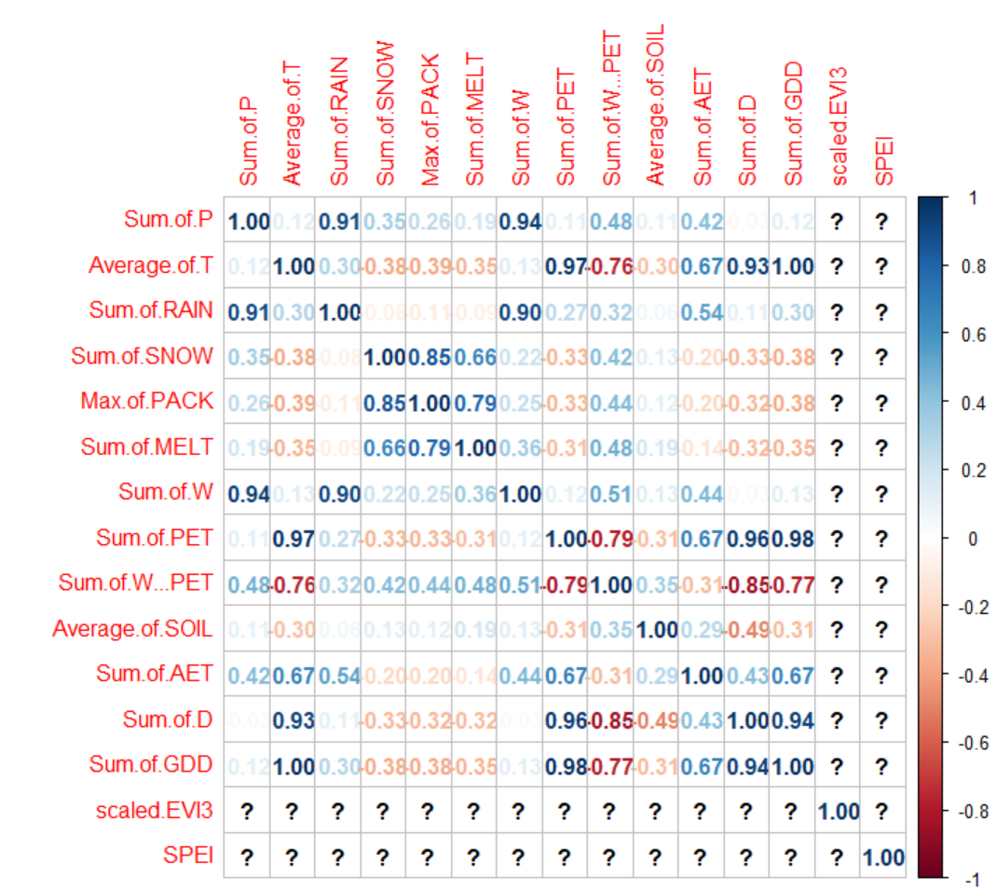
Previously discovered AET, SM, and Deficit had strongest relationship with AET
Examined Variables with less than 0.50 correlation
Precipitation, Snow Melt, Deficit, AET, and Soil Moisture

Slide 5
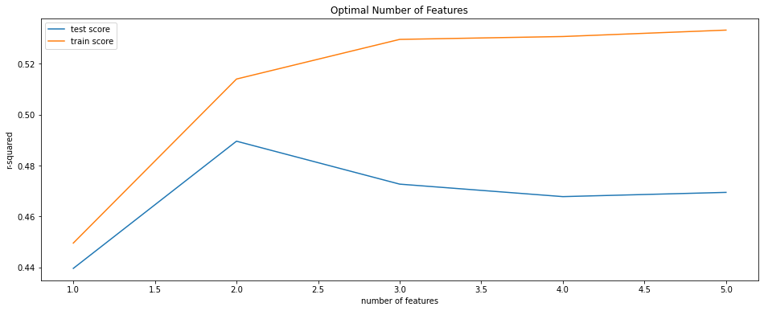
Feature Selection of All year data

Slide 6
Final Multinomial Linear Regression Model
Best Predictors found after recursive feature selection:
Snowmelt and AET
r² = 0.5301
Root Mean Squared Error = 0.009079
Improved r2 and Root Mean Squared Error compared to single variable approach

Slide 7
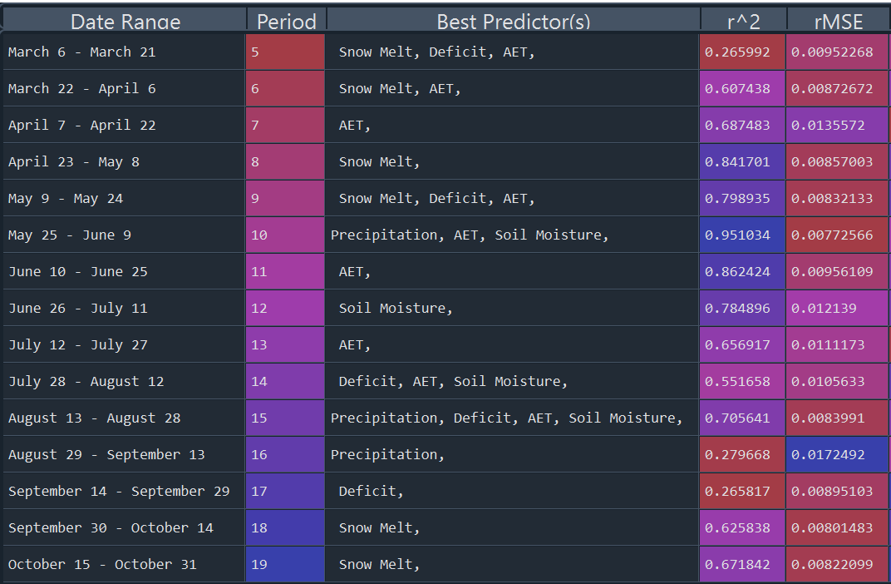
Periodic Approach to Predicting EVI through water balance data

Slide 8
Final Periodic Multinomial Linear Regression Model
Improved r2 value from simple linear regression models established with Deficit, AET, and Soil Moisture for periodic approaches.
Incorporating Snow Melt as a predictor improved significantly improved early and late growing season EVI predictive metrics
12/14 growing season periods had a higher r2 value than non-periodic model
8/14 growing season periods had a lower Root MSE than non-periodic model

Slide 9
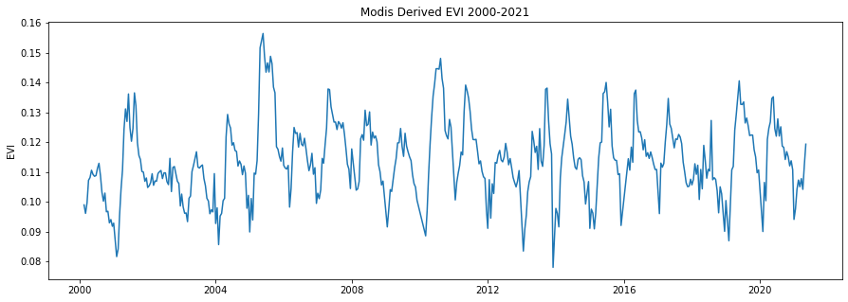

Slide 10
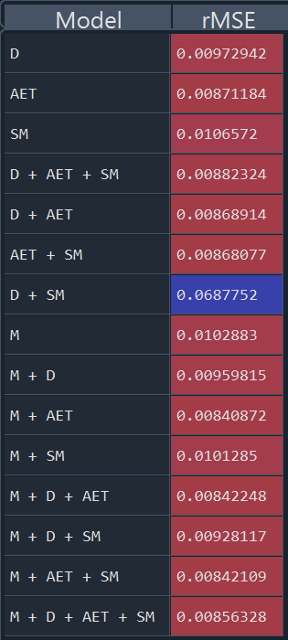
Comparison of ARIMAX models with different features

Slide 11
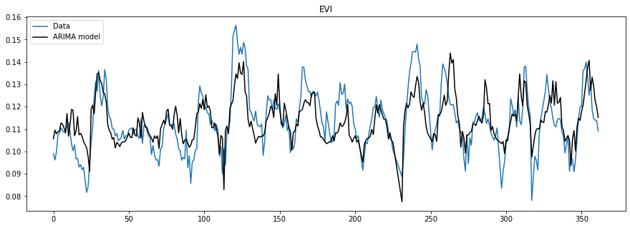
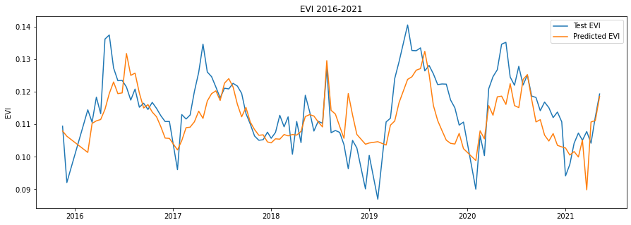
Predictors with Best rMSE = AET & Snowmelt
Root MSE = 0.00840872

Slide 12
Conclusions
Both the non-periodic Polynomial Linear Regression model and the Arimax model were optimized using AET and Snow Melt as predictors
The polynomial Linear Regression model using the periodic approach best fit the height of the growing season

Slide 13
Potential Issues
Limitations with Python Package (sklearn) used in refining equations after recursive feature selection.
(Not fully removing unselected features just minimizing their contributions)

Slide 14
Future Areas of Exploration
Incorporate pivot points
Develop periodic polynomial/simple linear relationships with the best predictors determined by recursive feature selection outside of sklearn package
Rerun gridsearch algorithm to optimize for test data root MSE instead of training data r2 value

Slide 15
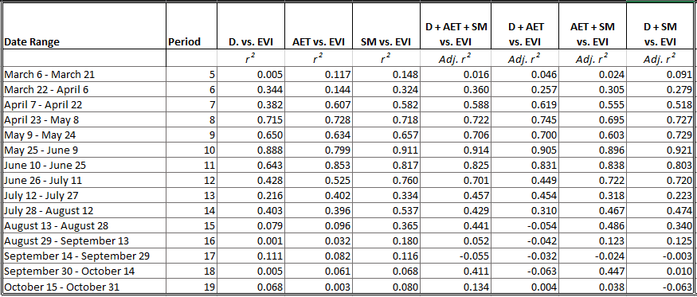
Periodic r2 values generated

Slide 16
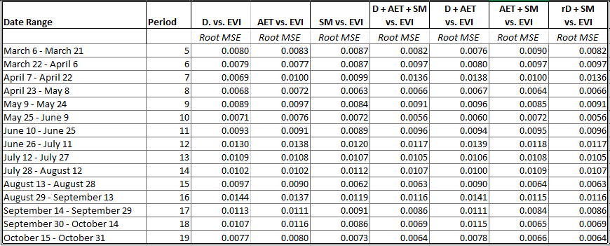
Periodic MSE values

Slide 17
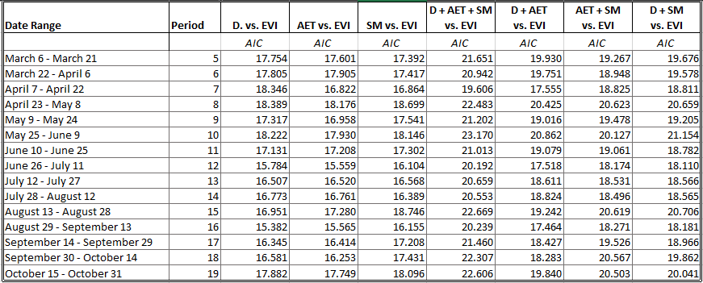
Periodic AIC values

Slide 18
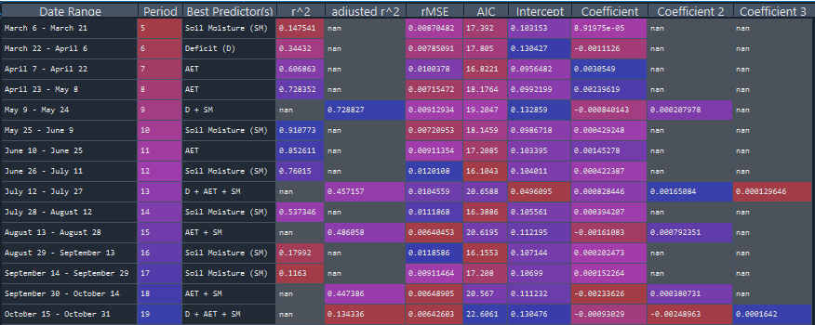

Slide 19
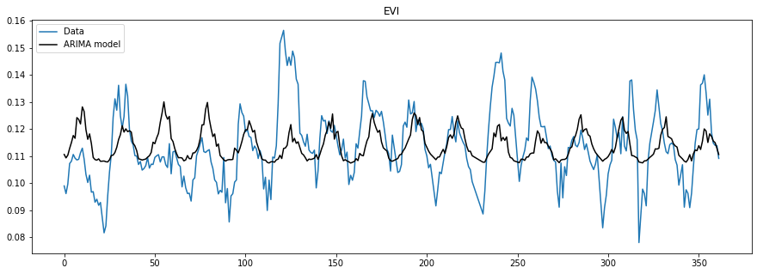
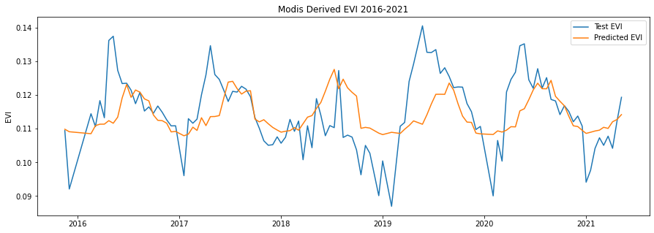
Predictor = Deficit
Root MSE = 0.00972942

Slide 20
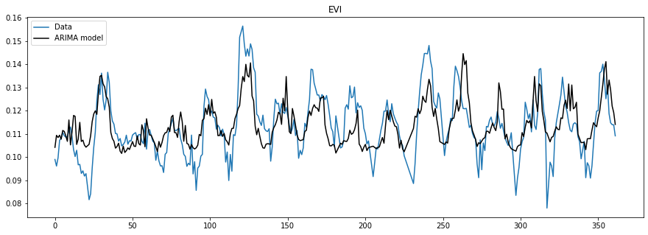
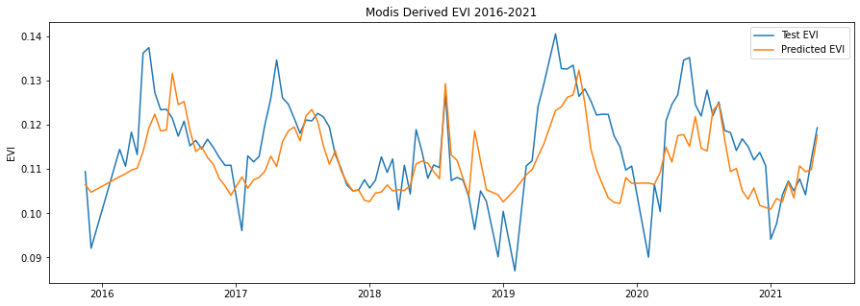
Predictor = AET
Root MSE = 0.00871184

Slide 21
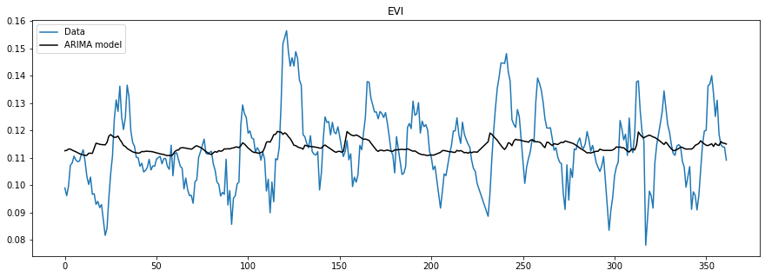
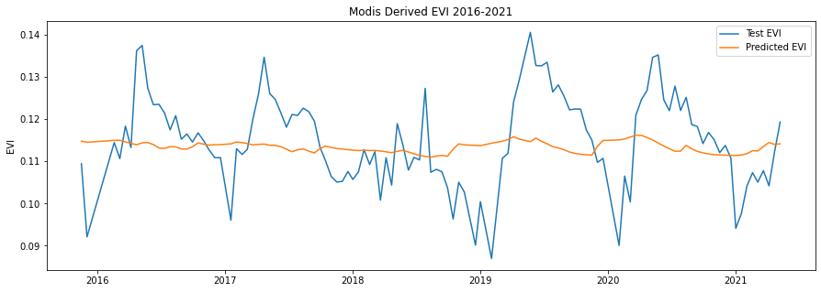
Predictor = SM
Root MSE = 0.0106572

Slide 22
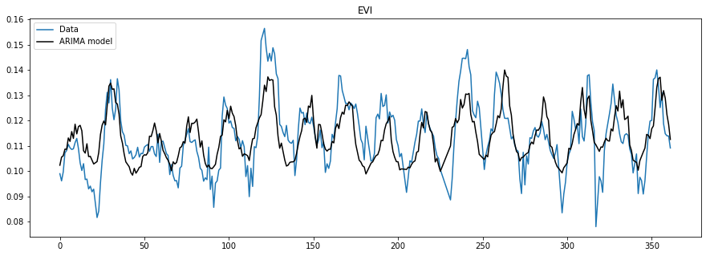
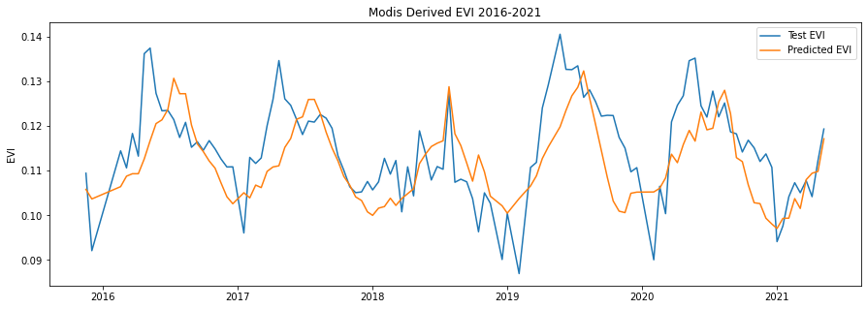
Predictors = D + AET +SM
Root MSE = 0.00882324

Slide 23
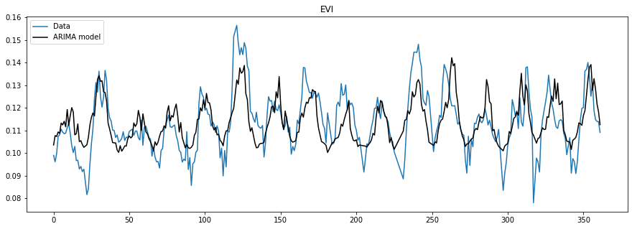

Predictors = D + AET
Root MSE = 0.00868914

Slide 24
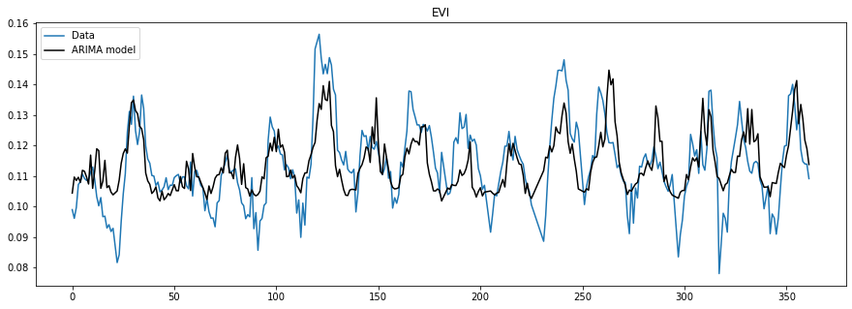
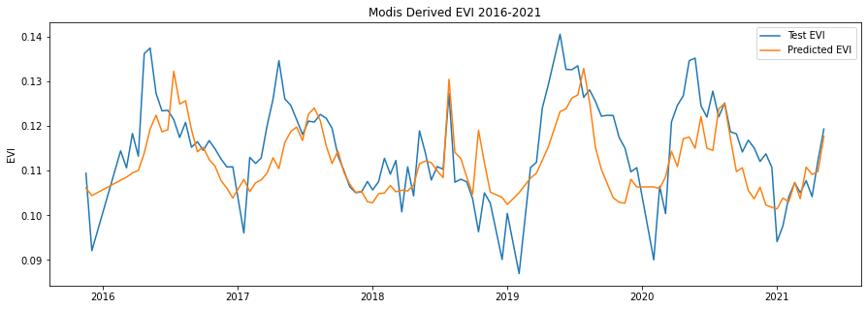
Predictors = AET + SM
Root MSE = 0.00868077

Slide 25
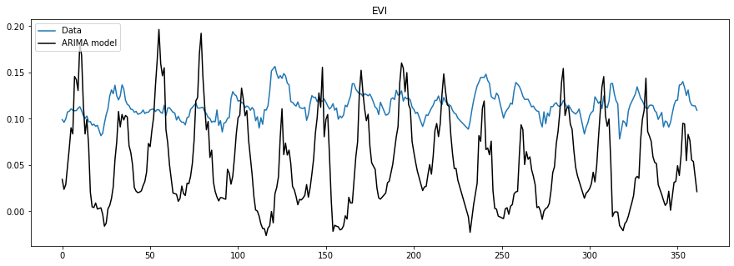
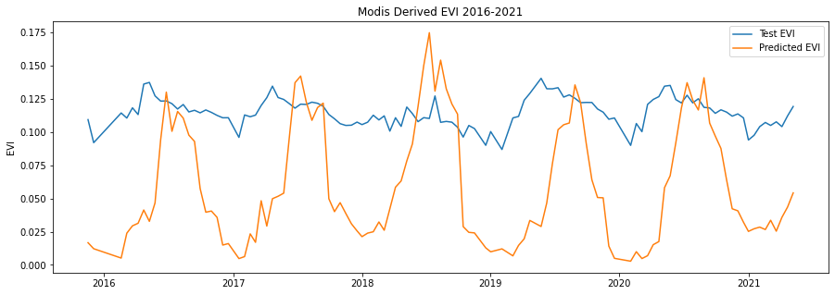
Predictors = D + SM
Root MSE = 0.0687752

